Slide 1
IPv6

Slide 2
Dynamic Routing

Slide 3
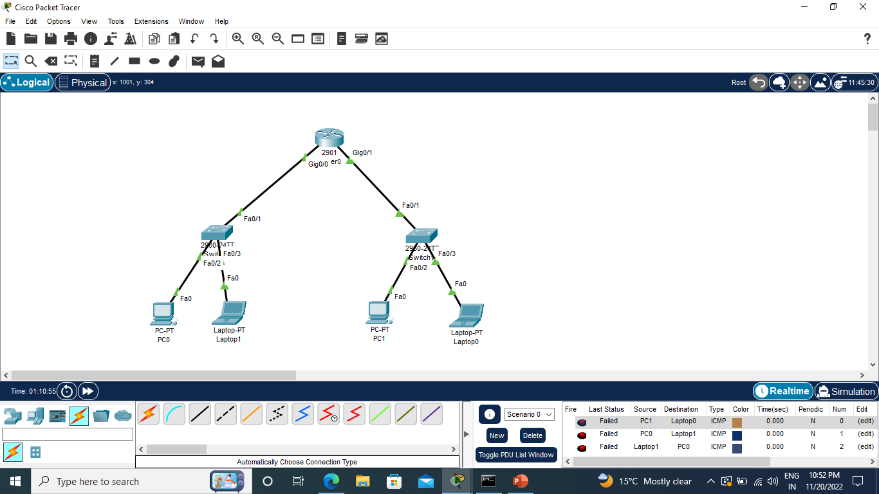

Slide 4
Router>enable
Router#configure terminal
Router(config)#interface GigabitEthernet0/0
Router(config-if)#ipv6 address 1:2:3::6:7:8/64
Router(config-if)#no shutdown
Router(config)#interface GigabitEthernet0/1
Router(config-if)#ipv6 address 11:2:3::6:7:8/64
Router(config-if)#no shutdown

Slide 5
Router>enable
Router#configure terminal
Router(config)#ipv6 unicast-routing (globally enable IPv6 using the ipv6 unicast- routing command in global configuration mode)
Router(config)#ipv6 router rip cisco (Use the keyword(n1) to identify a specific IPv6 RIP routing process)
Router(config-rtr)#interface gig0/0
Router(config-if)#ipv6 rip cisco enable (enable IPv6 on any interfaces on which IPv6 RIP is to be enabled)
Router(config-if)#interface gig0/1
Router(config-if)#ipv6 rip cisco enable

Slide 6
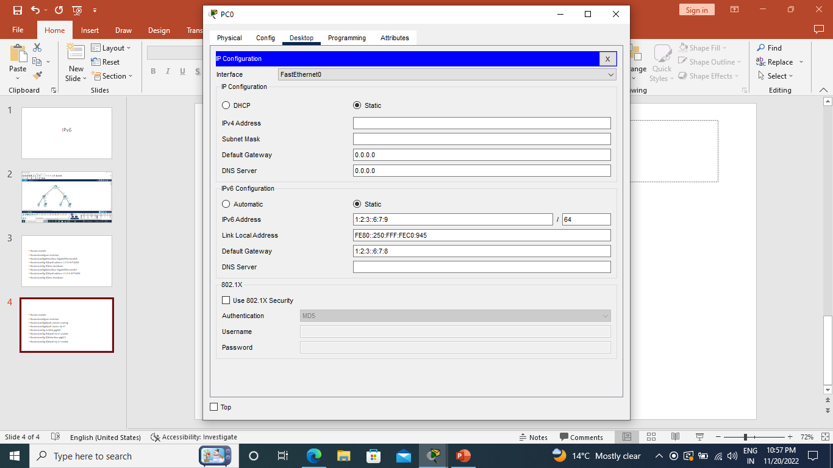

Slide 7
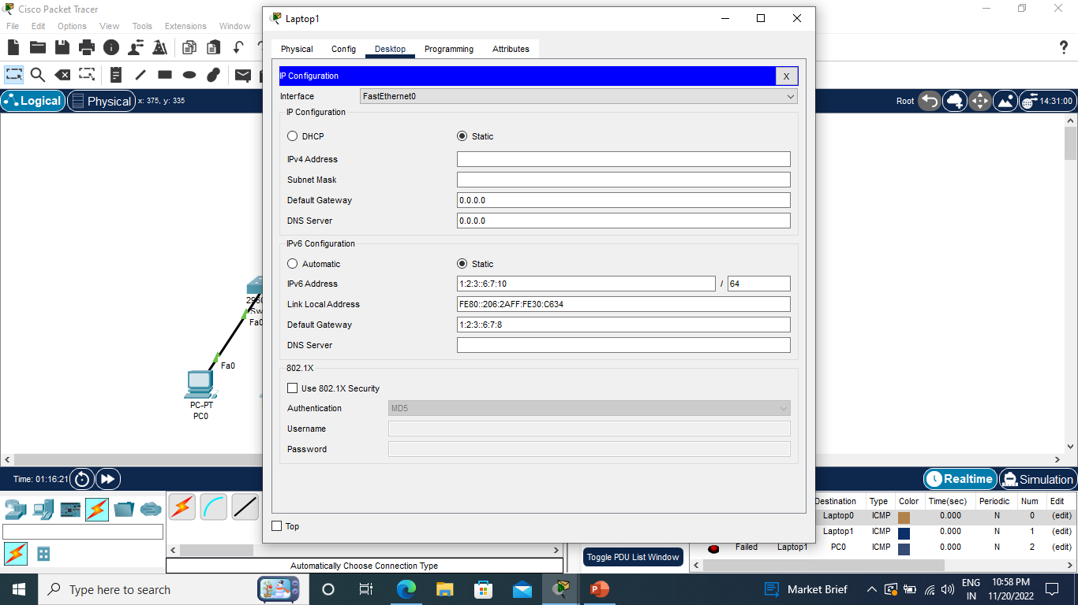

Slide 8


Slide 9


Slide 10
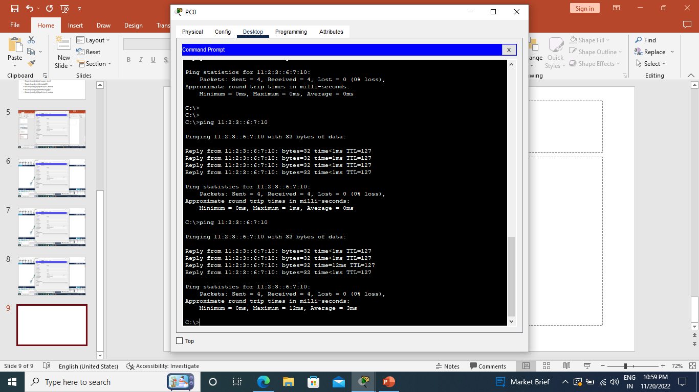

Slide 11
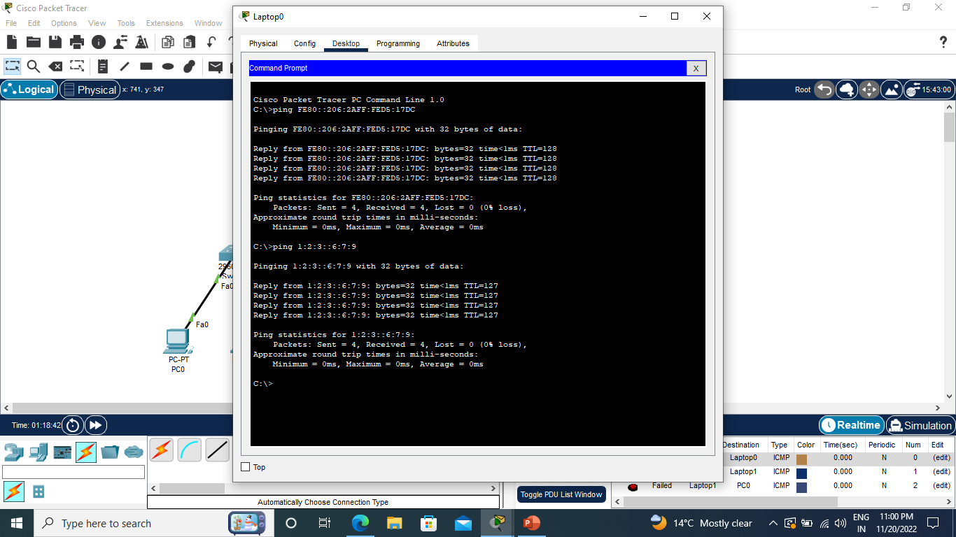

Slide 12
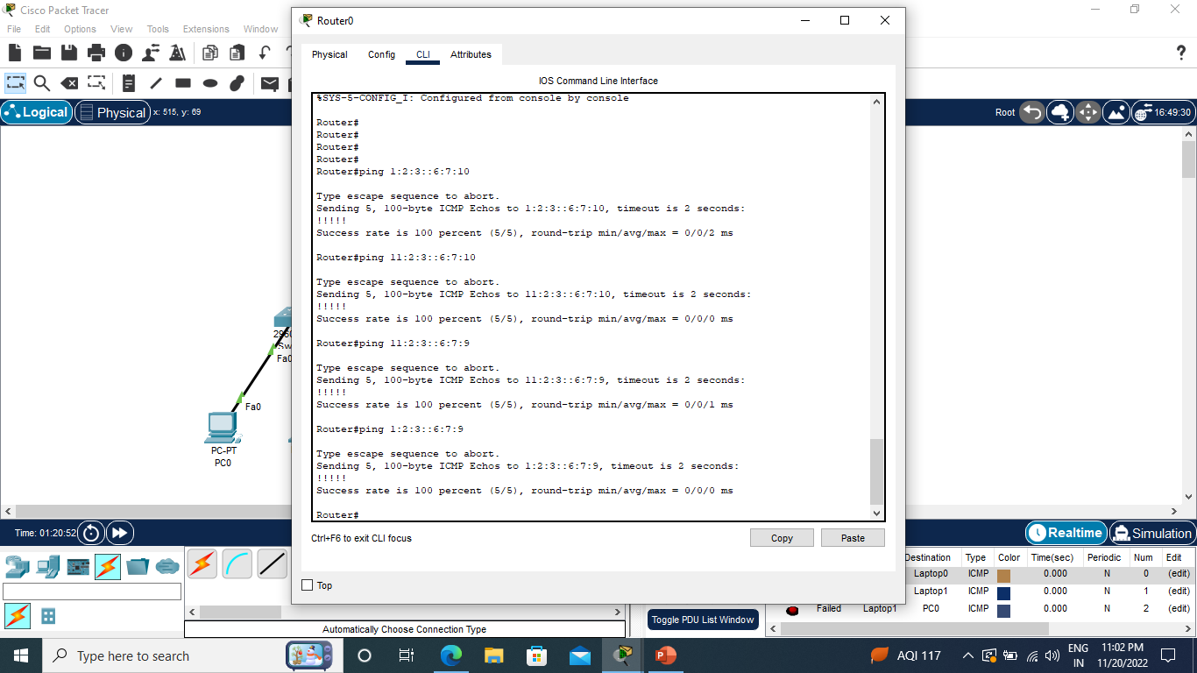

Slide 13
Static Routing

Slide 14
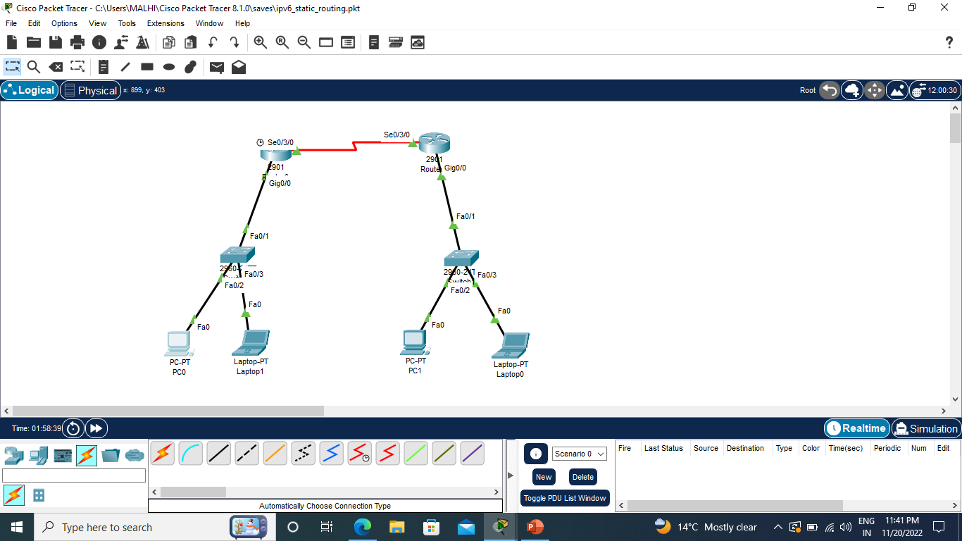

Slide 15
R1
Router>enable
Router#configure terminal
Router(config)#interface GigabitEthernet0/0
Router(config-if)#ipv6 address 1:2:3::6:7:8/64
Router(config-if)#no shutdown
Router(config-if)#interface se0/3/0
Router(config-if)#ipv6 address 2:2:3::6:7:8/64
Router(config-if)#clock rate 64000
Router(config-if)#no shutdown
Router(config-if)#exit
Router(config)#ipv6 unicast-routing
Router(config)#ipv6 route 11:2:3::/64 2:2:3::6:7:9

Slide 16
R2
Router>enable
Router#configure terminal
Router(config)#interface GigabitEthernet0/0
Router(config-if)#ipv6 address 11:2:3::6:7:8/64
Router(config-if)#no shutdown
Router(config-if)#interface se0/3/0
Router(config-if)#ipv6 address 2:2:3::6:7:9/64
Router(config-if)#no shutdown
Router(config-if)#exit
Router(config)#ipv6 unicast-routing
Router(config)#ipv6 route 1:2:3::/64 2:2:3::6:7:8

Slide 21
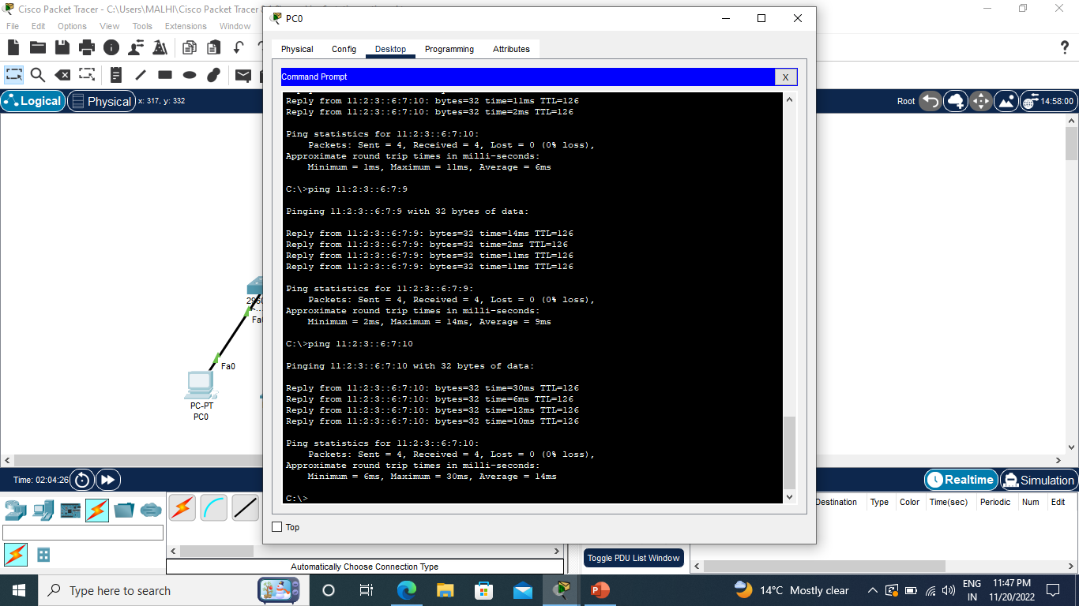

Slide 22


Slide 23
SLAAC (Stateless Address Auto Configuration)

Slide 24
Like IPv4, there are a number of different ways that a host can be addressed in IPv6; the two most common in IPv4 are static addressing and dynamic address configuration via the Dynamic Host Configuration Protocol (DHCP).
Often the reason that engineers use DHCP is that it not only provides a method of dynamically assigning addresses, it also provides a way to assign the host devices other service information like DNS servers, domain names, and a number of different custom information.

Slide 25
To perform address configuration on IPv6 there are a couple of familiar methods and a few additional methods, including: static addressing, static addressing with DHCPv6 (stateless), dynamic addressing via DHCPv6 (Stateful), SLAAC alone, or SLAAC with DHCPv6 (Stateless).
IPv6 static addressing works exactly the same as IPv4 static addressing so there is no mystery there.
IPv6 does, however, provide two different ways of implementing DHCP, either stateful (e.g., when an IPv4 DHCP server tracks the addresses that are given out) and stateless.
Stateless DHCP does not track what information is given out to clients and does not give out IPv6 addresses; instead, it provides the extra information that most people relate with typical DHCP assignment, e.g., DNS server information. Stateless DHCP is then matched up with another mechanism (such as Static addressing or SLAAC) for IPv6 address assignment.

Slide 26
A Solicited-Node multicast address is an IPv6 multicast address used by the Neighbor Discovery Protocol to verify whether a given IPv6 address is already used by the local-link or not, through a process called DAD (Duplicate Address Detection). This allows NDP to assign IPv6 addresses to hosts using SLAAC (IPv6 Stateless Address Autoconfiguration) without the risk of assigning addresses already in use.

Slide 27
IPv6 Neighbor Discovery

Slide 28
The IPv6 neighbor discovery process uses Internet Control Message Protocol (ICMP) messages and solicited-node multicast addresses to determine the link-layer address of a neighbor on the same network (local link), verify the reachability of a neighbor, and track neighboring devices.

